Slide 1
Bank Telemarketing Prediction
CS677 : Data Science with Python

Slide 2
Dataset
https://archive.ics.uci.edu/ml/datasets/bank+marketing
Contains Numerical and Categorical features.
Number of Instances: 45211
Number of Attributes: 16 + output attribute.

Slide 3
Goal : Classification
The goal is to predict if the client will subscribe a term deposit (variable y).
Predicting the term deposit category by applying various classification algorithms.

Slide 4
Exploratory Data Analysis
Young age group are more interested in term deposits. The amount of customers subscribing to term deposit gradually reduces after a certain thershold age of 40 .
Management, Technician, admin , bluecollar jobs have significant term deposits compared to other professionals.
Divorced people are unlikely to subscribe into term deposits.
Default people will not be subscribed into term deposits.
People with no housing/personal loan are more subscribed into term deposits.
Good way in direct marketing campaign to convince the customers is through cellular connection instead of unknown & telephone.
December month will have zero customers enrolling into term deposit.
About 1.8% of people have been defaulted.
More than 50% of users are having housing loan.
Most of them are having secondary education.
About 16% of users do have personal loan.

Slide 5
Feature Construction & Feature Selection
Feature construction :
There were no null values for any of the columns.
Some of the data rows with unknown values for some of the features were being removed.
CustomEncoder for Categorical columns having yes/no values.
CustomDummifier for categorical columns where order is not important.
Feature Selection :
Correlation Chooser:
SelectKbest
SelectFromModel
=> After applying above methods 4 features were being selected for modelling work.

Slide 6
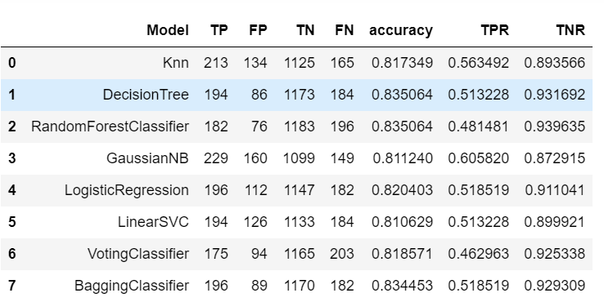
Models

Slide 7
Pickle File.
Deploying the model using the pickle file.
The best model with higher accuracy, TPR and TNR values has been saved into pickle file.
Created a webapp using streamlit API , which accepts features and predicts the output from the classifier model.

Slide 8
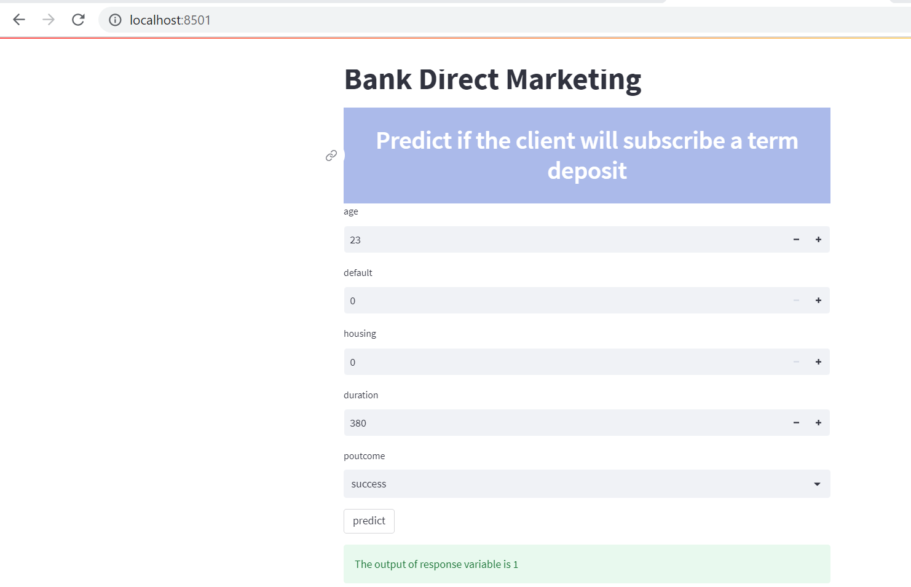

Slide 9
Thank You

